Slide 1

Memory analysis
Joakim Kävrestad Jönköping University joakim.kavrestad@ju.se
© Crown Copyright, The National Cyber Security Centre 2023. This information is licensed under the Open Government Licence v3.0. To view this licence, visit https://www.nationalarchives.gov.uk/doc/open-government-licence/version/3/.
When you use this information under the Open Government Licence, you should include the following attribution: CyBOK memory analysis slides © Crown Copyright, The National Cyber Security Centre 2023, licensed under the Open Government Licence: https://www.nationalarchives.gov.uk/doc/open-government-licence/version/3/.

Slide 2
Agenda
Intro to theory
Data in memory
Malware structures
Memory analysis with Volatility
Volatility demo
Set up the environment
Quick start

Slide 3
Literature note
This lecture is based on the following CyBOK knowledge areas:
Forensics
Malware & Attack Technologies

Slide 4
Data in memory
Running memory holds information relating to what the computer is currently up to
Volatile
Temporary
Removed on power-cycle
Recent
Put there since last boot

Slide 5
Data in memory – properties
True form
Unencrypted
Unobfuscated
Memory-only data
Memory resident malware
Temporary data such as passwords

Slide 6
Data in memory – special cases
SWAP-partitions
Pagefile/hiberfile
Memory actually fades, rather than is directly removed, on power-off

Slide 7
Data in memory
Memory is an array of pages
Processes are not assigned pages in physical memory but a virtual memory space
Size equal to physical memory
Easier memory allocation for the process
A page table maps virtual memory to physical memory

Slide 8
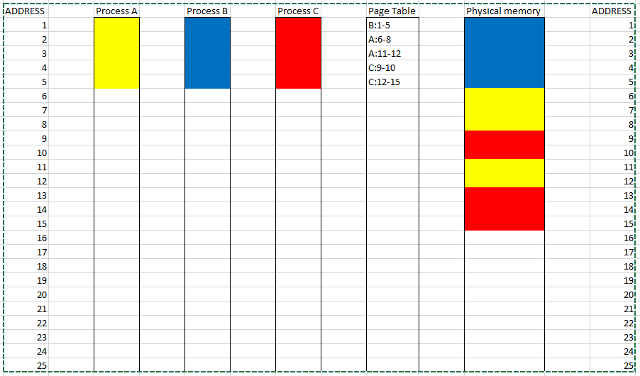
Data in memory – simplified paging

Slide 9
Data in memory
Different operating systems handle memory a bit differently
Paging scheme
Address space layout randomization (ASLR)
Some address space positions are randomized to make it hard for an attacker to guess the memory location of important processes

Slide 10
Data in memory
What are the forensic purposes of memory analysis?
Recent nature of data
True form of data
Memory is where the instructions to be executed are stored
Malware using evasion techniques
Bad behavior is manifested
True form of data
Encrypted data in plain text
Nuggets of temporary information
Volatile data

Slide 11
REFLECT!
Use one minute to write down one-liners that describe what you just learned – come up with as many as you can.
Join up in pairs or groups and compare your lists for another minute.
Questions so far?

Slide 12
Moving on

Slide 13
Malware
Malware is any malicious program
Great deal of diversity in
What they do
How they spread
How they hide

Slide 14
Malware – what they do
Encrypt data
Create a backdoor
Exfiltrate information
Slow down computer
Destroy information
Enlist device in bot-net
….

Slide 15
Malware – how they spread
Attachments
Drive-by-download
USB-stick
Using software vulnerabilities
Manually
…

Slide 16
Malware – how they hide
Encryption
Polymorphism or Metamorphism
Memory-resident (file-less)
….

Slide 17
REFLECT!
Use one minute to write down one-liners that describe what you just learned – come up with as many as you can.
Join up in pairs or groups and compare your lists for another minute.
Questions so far?

Slide 18
Moving on

Slide 19
Memory analysis with Volatility
Memory analysis is about analysing memory with the intent of finding something
On-line analysis of a running computer
Off-line analysis of a memory dump

Slide 20
Memory analysis with Volatility
Off-line analysis is better when possible
No need to allow infected machines to run
Less time-sensitive because a machine state is stored indefinitely
Complies with forensic best practice
Requires memory to be dumped with a tool or cold-boot procedure
Requires a tool that can understand the content of a memory dump

Slide 21
Memory analysis with Volatility
Volatility is a command-line tool for memory analysis
Two versions
2.6: discontinued but still with many useful functions
3: newer but less extensive in terms of functionality
There is also a GUI tool called Volatility Workbench

Slide 22
Memory analysis with Volatility
Malware is an anomaly
Finding an anomaly means knowing what is normal and finding deviations from that
Being a good memory analyst requires research and experience

Slide 23
Memory analysis with Volatility
A helpful starting point is to consider what malware may want to do
In an incident handling process this would be manifested as “the incident”
Find what is causing the anomalous behavior
Some starters
Spawn processes
Irregular process behavior (start/stop)
Address strange memory areas
Spawn network sockets
Issue command line arguments
Store data in the registry (Windows)
Encrypt

Slide 24
Memory analysis with Volatility
Use the internet!
Research the incident at hand
Use sites such as Virustotal for confirmation and review
Indicators of compromise
“manifests” of known malware
Can be used to search for bad behavior
Or specific malware
Some tools can do this automatically
Let’s demo.

Slide 25
Volatility– set up
Volatility 2.6 installation in Windows
Go to https://www.volatilityfoundation.org/26
Download Volatility 2.6 standalone executable
Open a PowerShell terminal and navigate to the folder containing Volatility
List of commands: https://github.com/volatilityfoundation/volatility/wiki/Command-Reference
Volatility 3 installation in Windows (You need python 3)
Download AND UNPACK Volatility 3
From web page: https://www.volatilityfoundation.org/3
Clone from git (ensures latest version): git clone https://github.com/volatilityfoundation/volatility3.git
Install some dependencies
Python -m pip install pefiles
Open a PowerShell terminal and navigate to the Volatility folder containing “vol.py”
You can now run Volatility by issuing the command python vol.py

Slide 26
Volatility 2.6
Framework with a set of modules
Executed by running the executable from command line
.\volatility_2.6_win64_standalone.exe -f memdumpfilename -–profile=”profilename” modulename
Verify by asking for help
.\volatility_2.6_win64_standalone.exe -h

Slide 27
Volatility 3
Script that calls other scripts (modules)
Executed by running the executable from command line
Python vol.py -f memdumpfilename modulename
Verify by asking for help
Python vol.py -h

Slide 28
REFLECT!
Use one minute to write down one-liners that describe what you just learned – come up with as many as you can.
Join up in pairs or groups and compare your lists for another minute.
Questions so far?

Slide 29
Demo time – quick start
Let’s begin with a short demo before you explore on your own.
The demo is available in the compendium

Slide 30
Thank you for today!

